Slide 1
Chapter 8: Shift Registers

Slide 2
Chapter Objectives
After studying this chapter, students should be able to:
Identify the basic forms of data movement in shift registers.
Explain the operation of serial-in/serial-out, serial-in/parallel-out, parallel-in/serial-out, and parallel-in/parallel-out shift registers.
Describe how a bidirectional shift register works and set up a Johnson counter or a ring counter from a shift register.
Use a shift register as a time-delay device or a shift-register-controlled keyboard encoder.
Apply shift registers to implement serial-to-parallel data conversion.
Interpret ANSI/IEEE Standard 91-1984 shift register symbols and use shift registers in system applications.

Slide 3
Chapter Outline
8.1: Shift Register Operations 8.2: Types of Shift Register Data I/Os 8.3: Bidirectional Shift Registers 8.4: Shift Register Counters 8.5: Shift Register Applications 8.6: Logic Symbols with Dependency Notation
Multiple-choice test and Problems

Slide 4
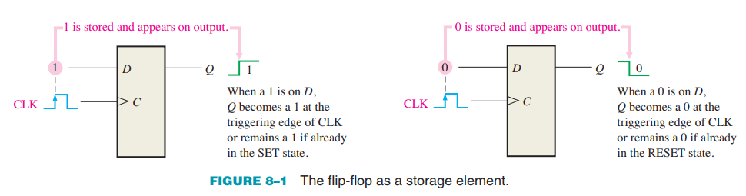
8.1: Shift Register Operations
Shift registers consist of arrangements of flip-flops and are important in applications involving the storage and transfer of data in a digital system.

Slide 5
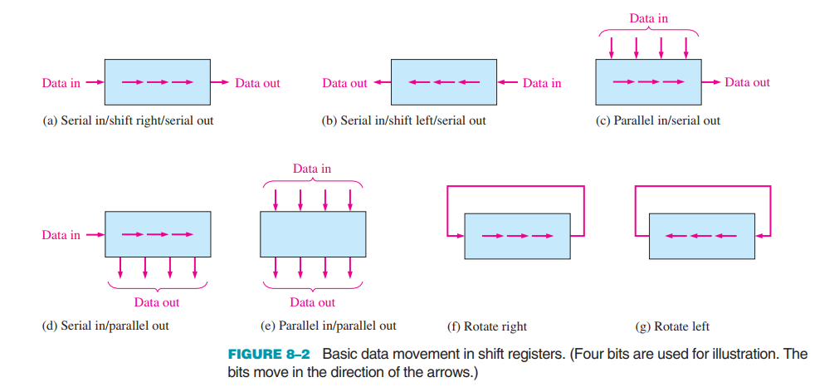
8.1: Shift Register Operations
The shift capability of a register permits the movement of data from stage to stage within the register or into or out of the register upon application of clock pulses.

Slide 6
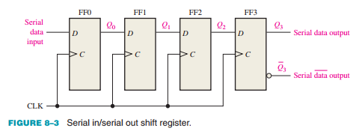
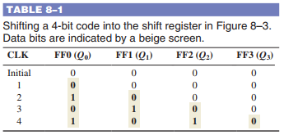
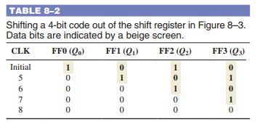

8.2: Types of Shift Register Data I/Os
Serial In/Serial Out Shift Registers The serial in/serial out shift register accepts data serially—that is, one bit at a time on a single line. It produces the stored information on its output also in serial form. Let’s first look at the serial entry of data into a typical shift register.

Slide 7
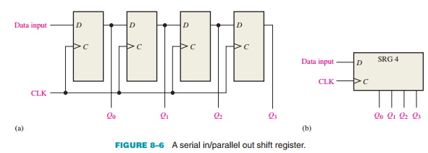
8.2: Types of Shift Register Data I/Os
Serial In/Parallel Out Shift Registers Data bits are entered serially (least-significant bit first) into a serial in/parallel out shift register in the same manner as in serial in/serial out registers. The difference is the way in which the data bits are taken out of the register; in the parallel output register, the output of each stage is available.

Slide 8
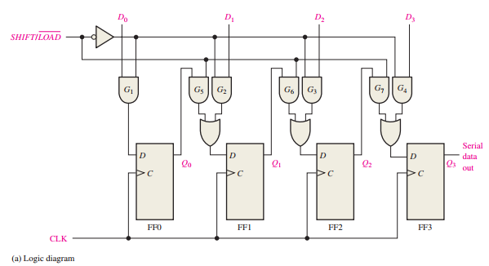
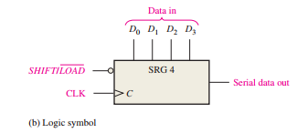
8.2: Types of Shift Register Data I/Os
Parallel In/Serial Out Shift Registers For a register with parallel data inputs, the bits are entered simultaneously into their respective stages on parallel lines rather than on a bit-by-bit basis on one line as with serial data inputs. The serial output is the same as in serial in/serial out shift registers, once the data are completely stored in the register.

Slide 9
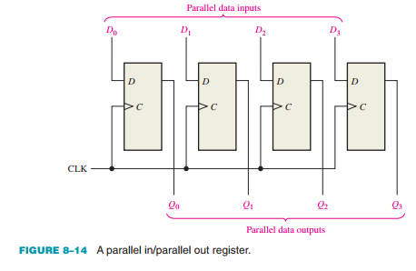
8.2: Types of Shift Register Data I/Os
Parallel In/Parallel Out Shift Registers Parallel entry and parallel output of data have been discussed. The parallel in/parallel out register employs both methods. Immediately following the simultaneous entry of all data bits, the bits appear on the parallel outputs.

Slide 10
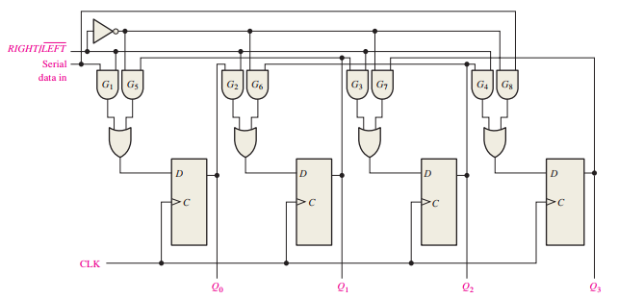
8.3: Bidirectional Shift Registers
A bidirectional shift register is one in which the data can be shifted either left or right. It can be implemented by using gating logic that enables the transfer of a data bit from one stage to the next stage to the right or to the left, depending on the level of a control line.

Slide 11
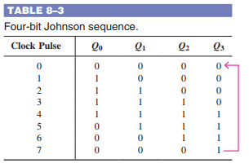
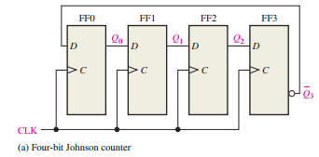
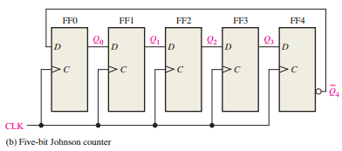
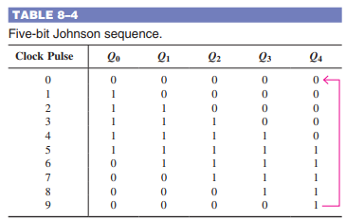
8.4: Shift Register Counters
The Johnson Counter In a Johnson counter, the complement of the output of the last flip-flop is connected back to the D input of the first flip-flop (it can be implemented with other types of flip-flops as well).

Slide 12
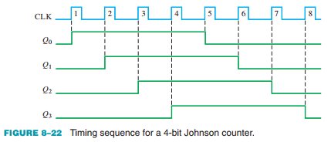
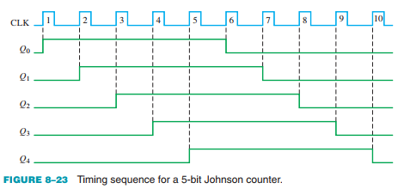
8.4: Shift Register Counters
The Johnson Counter In a Johnson counter, the complement of the output of the last flip-flop is connected back to the D input of the first flip-flop (it can be implemented with other types of flip-flops as well).

Slide 13
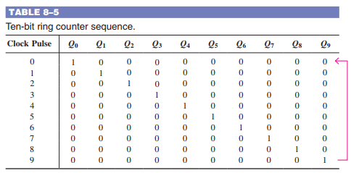
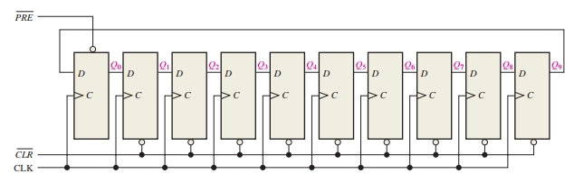
8.4: Shift Register Counters
The Ring Counter A ring counter utilizes one flip-flop for each state in its sequence. It has the advantage that decoding gates are not required. In the case of a 10-bit ring counter, there is a unique output for each decimal digit.

Slide 14
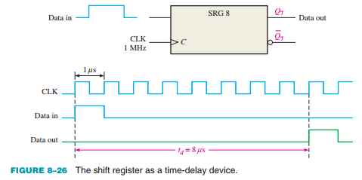
8.5: Shift Register Applications
Time Delay A serial in/serial out shift register can be used to provide a time delay from input to output that is a function of both the number of stages (n) in the register and the clock frequency.

Slide 15
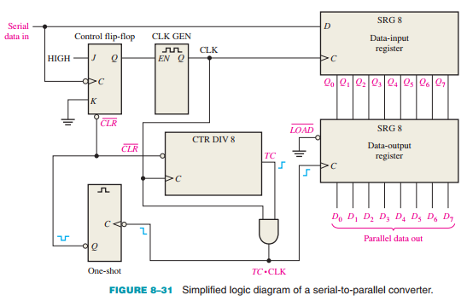
8.5: Shift Register Applications
Serial-to-Parallel Data Converter Serial data transmission from one digital system to another is commonly used to reduce the number of wires in the transmission line.

Slide 16
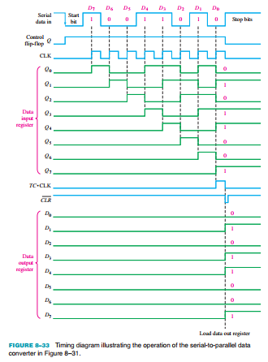
8.5: Shift Register Applications
Serial-to-Parallel Data Converter Serial data transmission from one digital system to another is commonly used to reduce the number of wires in the transmission line.

Slide 17
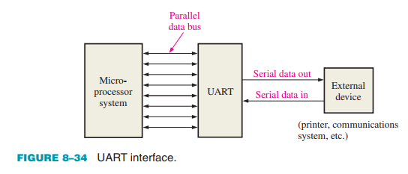
8.5: Shift Register Applications
Universal Asynchronous Receiver Transmitter (UART) As mentioned, computers and microprocessor-based systems often send and receive data in a parallel format.

Slide 18
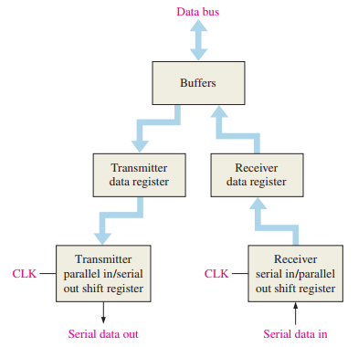
8.5: Shift Register Applications
A UART includes both serial-to-parallel and parallel-to-serial conversion, as shown in the block diagram in Figure 8–35.
The UART receives data in serial format, converts the data to parallel format, and places them on the data bus. The UART also accepts parallel data from the data bus, converts the data to serial format, and transmits them to an external device.

Slide 19
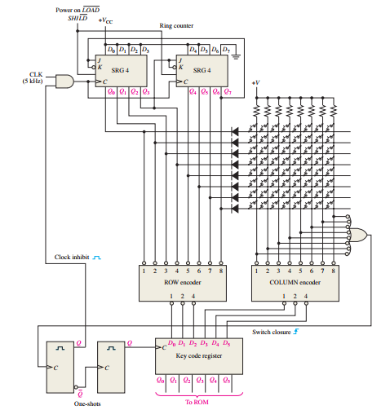

8.5: Shift Register Applications
Keyboard Encoder The keyboard encoder is a good example of the application of a shift register used as a ring counter in conjunction with other devices

Slide 20
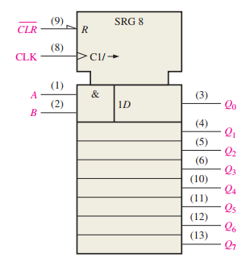
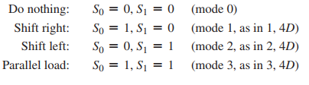
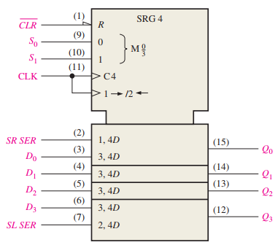

8.6: Logic Symbols with Dependency Notation
Two examples of ANSI/IEEE Standard 91-1984 symbols with dependency notation for shift registers are presented. Two specific IC shift registers are used as examples.

Slide 21
SUMMARY
Chapter 8: Shift Registers
Latches are bistable devices whose state normally depends on asynchronous inputs.
Edge-triggered flip-flops are bistable devices with synchronous inputs whose state depends on the inputs only at the triggering transition of a clock pulse. Changes in the outputs occur at the triggering transition of the clock.
Monostable multivibrators (one-shots) have one stable state. When the one-shot is triggered, the output goes to its unstable state for a time determined by an RC circuit.
Astable multivibrators have no stable states and are used as oscillators to generate timing waveforms in digital systems.

Slide 22
MULTIPLE-CHOICE TEST AND PROBLEMS
Complete the true/false questions, multiple-choice questions, and end-of-chapter exercises in the primary textbook.

